Slide 1
Chronic Absenteeism & Child Health:
To Excuse or Not to Excuse
The Massachusetts Chapter of the American Academy of Pediatrics
in Partnership with Attendance Works
Mona Roberts, DO, FAAP
Mary Beth Miotto, MD, MPH, FAAP
September 25, 2024
6-7 PM
Notes:
On behalf of the Massachusetts Chapter of the American Academy of Pediatrics and my colleague Dr. Mona Robers, I’d like to welcome everyone to our program on Chronic Absenteeism and Child Health. Undoubtedly many of you have heard about the national, statewide,and local crisis level post-COVID increase in school absenteeism, and together we will explore the root causes of chronic school absenteeism and help spread the word to the other members of our health team ways in which we can be part of the solution.

Slide 2
Housekeeping
Stay on mute but use the chat function to make your “voice” heard
CME/MOC2 Credit
MOC 4 Credit Opportunity: Contact chaggerty@mcaap.org
Recording and Slide Deck will be posted
Notes:
Before we jump in, let me just quickly review some housekeeping. We are very happy to hear your questions and observations through the program but please share through the chat. We will review your questions and address them at the end of the program.
This educational activity can provide you with both CME and MOC 2 credit if you complete the assessment sent to you at the end of the program. If you are paying attention, you will have no difficulty answering the questions.
We also are piloting a new opportunity for members to obtain MOC Part 4 credit starting at this webinar and that is the option to participate in a simple longitudinal quality improvement initiative in your own practice with flexible data tracking. If you are interested, please contact our Chapter Executive Director Cathleen Haggerty within 3 weeks of this program. That is a deadline of October 16 just to inquire and sign up if interested.
You will receive an email after the program and the recording and slide deck will be posted on the MCAAP.Org website under education.

Slide 3
Disclosures
Dr. Roberts and Dr. Miotto have no relevant actual or potential conflicts of interest or financial relationships with the manufacturers or providers of any commercial product to disclose.
No off-label use of medications will be discussed.
Notes:
For full transparency, neither Dr. Roberts nor I, or any planners involved in this presentation, have any conflicts of interest to disclose and we will not be discussing any medication or therapy use. And please join me in welcoming Dr. Mona Doss Roberts who will kick off our program.

Slide 4
Learning Outcomes
Understand current data around chronic absenteeism and why it matters
Describe health-related causes and implications of chronic absenteeism for well-being
Identify evidence-based physical and mental health interventions that can improve attendance and reduce inequities
Discuss how schools and healthcare providers can collaborate to promote school attendance
Notes:
Participants will be able to:
1. Understand chronic absenteeism and why it matters.
2. Describe major causes of absenteeism including health-related factors.
3. Identify evidence-based physical and mental health interventions that can improve attendance and reduce inequities.
4. Discuss how schools and healthcare providers can collaborate to promote school attendance.

Slide 5
Notes:
Dr. Joycelyn Elders was the first African American and only the second woman to head the U.S. Public Health Service.

Slide 6
Chronic absence is missing so much school for any reason that a student is academically at risk.
Chronic absence is defined as missing 10 percent or more of school for any reason.
What is chronic absence?
Excused
absences
Unexcused
absences
Chronic Absence
Suspensions
Chronic absence is different from truancy (unexcused absences only) or average daily attendance (how many students show up to school each day).
Notes:
Chronic absence is when a student misses 10% or more of their days on roll for any reason, whether it is excused, unexcused or due to suspension.
Chronic absence is designed to serve as an early warning metric for when students are at risk academically due to poor attendance. It’s 2 days a month in the first month, 4 days in the second month, 6 days in the third month.
It’s different from truancy (which only measures unexcused absences) or average daily attendance (which measures the average number of students that show up each day of school).
Chronic absence is the rate of absenteeism that highly correlates with students falling off the path toward academic success.

Slide 7
What’s the difference between ADA, truancy & chronic absence?
Average Daily Attendance (ADA)
Truancy
Chronic Absence
School level measure (not student level)
Notices aggregate attendance at certain point in time (e.g., half-days, holidays, bad weather)
Masks individual student chronic absences
Missing 10% counts ALL absences (excused, unexcused, & suspensions)
Emphasizes impact of missed days and the benefits of being present
Uses preventative, problem-solving, trauma-sensitive strategies
Cultivates family and student engagement
Counts ONLY unexcused absences
Emphasizes individual compliance with school rules
Uses legal, typically more blaming and punitive, solutions
https://www.attendanceworks.org/whats-the-difference-between-chronic-absence-and-truancy/
Notes:
What’s the difference between ADA, truancy and chronic absence?
ADA is a school level measure that tells how many students show up each day. It helps you notice when dips occur, but it masks individual student absences.
Truancy counts only unexcused absences, emphasizes compliance, and uses legal, typically more blaming and punitive solutions such as fining parents or taking away driving privileges
Chronic absence counts all absences.
Chronic absence emphasizes the impact of missed days and the benefits of being present, uses preventative, problem-solving, trauma-sensitive strategies.
And finally, it cultivates student and family engagement so that families and students are not problems to be solved, but are active in designing the solutions.
ADD TO TALKING POINTS HERE → add examples

Slide 8
The United States Faces an Attendance Crisis
Pre-pandemic: 8 million (1 out of 6) students were chronically absent (missing 10% or more of school for any reason: excused, unexcused, suspension)
Chronic absence is higher than ever, especially in early elementary and all throughout high school. By the end of school year (SY) 2021-22, data from multiple states showed chronic absence often doubled and affected more than 1 out of 4 students. Early district and state SY 2022-23 data show rates remain high.
Economically disadvantaged students and families as well as Native American, Black, Latino/Hispanic, and Pacific Islander students are disproportionately affected.
Using Chronic Absence to Map Interrupted Schooling, Instructional Loss and Educational Inequity
Monitoring Data Matters Even More: A Review of State Attendance Data Policy and Practice in School Year 2022-23
State Policy Review Table 2023
Notes:
The fact is, there is a crisis regarding attendance.
While chronic absence was already a major problem before the pandemic, it has grown dramatically.
Pre-pandemic: 8 million (1 out of 6) students were chronically absent, but now chronic absence is higher than ever. Data from multiple states shows it often doubled from pre-pandemic levels and often affects more than one out of four students. Between School Years (SYs) 2018-19 and 2021-22, chronic absence rates, for example, increased from 12.1 percent to 30 percent in California,12.9 to 27.7 percent in Massachusetts, 19.7 percent to 38.5 percent in Michigan,13.1 percent to 28 percent in Mississippi, and 16.7 to 30.2 percent in Ohio.
Unfortunately, certain populations of students are affected even more including those who are economically disadvantaged as well as Native American, Black, Latino and Pacific Islander students. Chronic absence is also higher among early elementary and high school students.

Slide 9
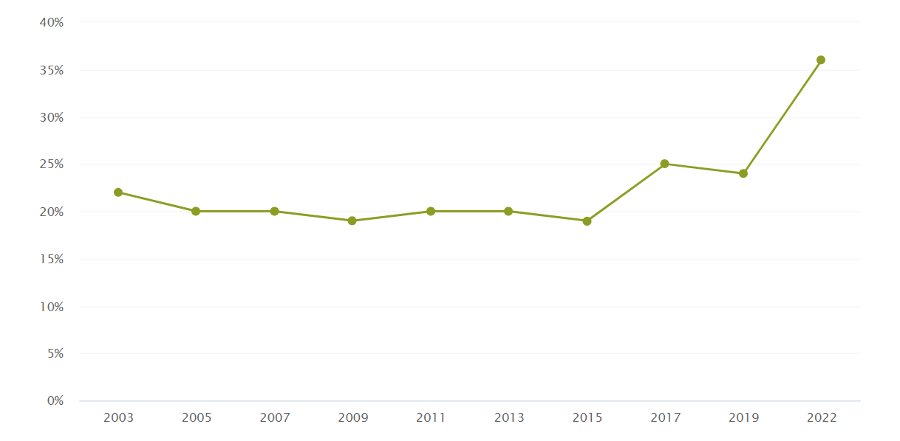
American Fourth Graders Who Are Chronically Absent From School
Tracking the Nationwide Trends from 2003-2022
From the Annie E Casey Foundation: https://shorturl.at/4J2zz
Notes:
More national data (I got it from Annie E Casey Foundation)

Slide 10
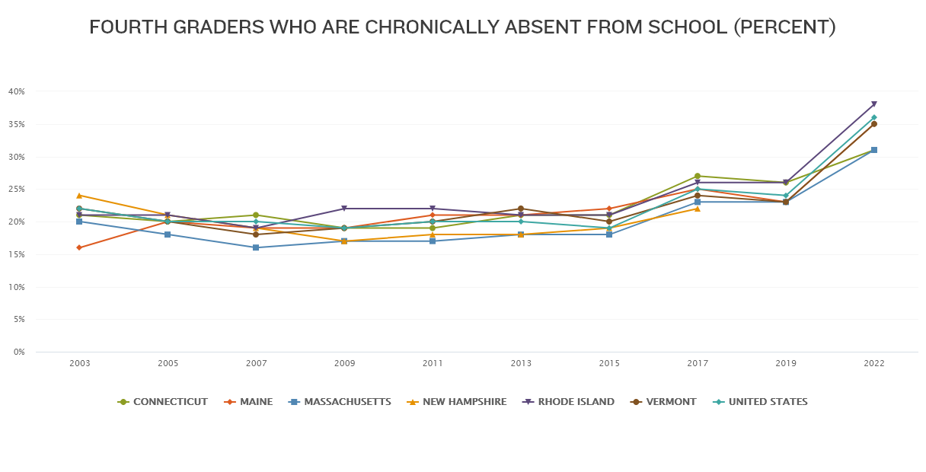
How Are We Doing: The New England States and the Nation 2003-2022
From Annie E Casey Foundation
Notes:
And focus in on New England from Annie E Casey Foundation

Slide 11
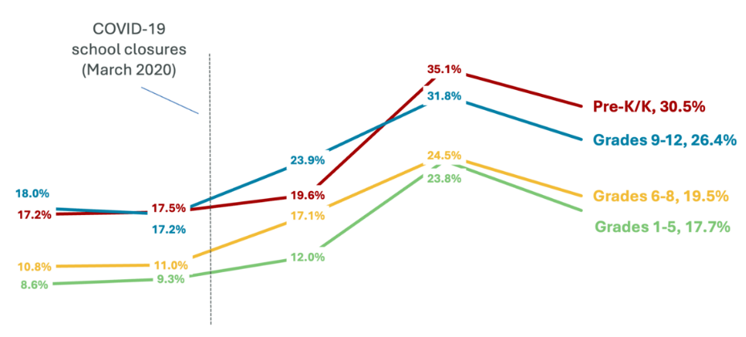
Massachusetts Data Trends by Grade Span
Chronic absenteeism is highest in PreK/K and high school
COVID 19
School closures
(March 2020)
Additional Insights
Chronically absent kindergarteners have lower attendance and lower achievement in future grades.
More than half of students who drop out were chronically absent 3 years prior.
Students in classrooms with high chronic absence feel a spillover effect; for example, lower test scores.
2018-19 2019-20 2020-21 2021-22 2022-23
From MA Department of Education Presentation, August 2024
Notes:
Sources:
https://educationtocareer.data.mass.gov/stories/s/vuut-f46x
https://www.gradpartnership.org/wp-content/uploads/2024/05/EGC-GP-NPSS-May-2024-Brief.pdf
https://annenberg.brown.edu/sites/default/files/EdResearch_for_Recovery_Brief_22.pdf

Slide 12
Do We See Disparities in Chronic Absenteeism?
Students with Disabilities
Black students
Students Experiencing Housing Instability
Native American and Pacific Islander
LatinX students
New Residents
Low Income Students
English Language Learners

Slide 13
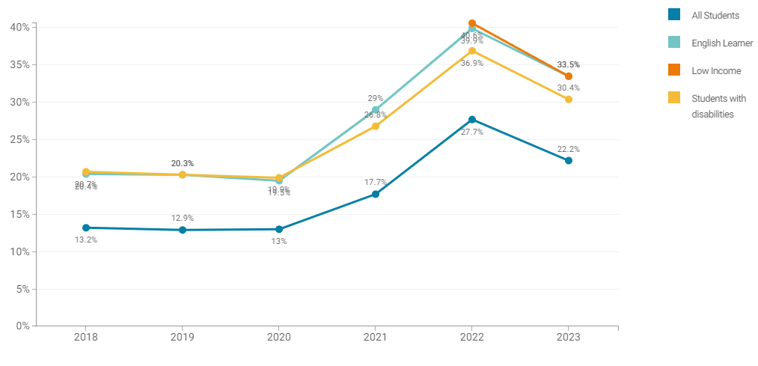
Massachusetts Trends by Specific Student Groups
Chronic absenteeism rates are higher for English learners,
low-income students, and students with disabilities
Additional Insights
National research shows the negative effects of school absences are larger for low-performing, low-income, and English learner students.
Almost half (47%) of high school English Learners missed 10% of school in 2022-2023.
Percent absent at least 10% of school year
From the MA Department of Education August 2024 presentation

Slide 14
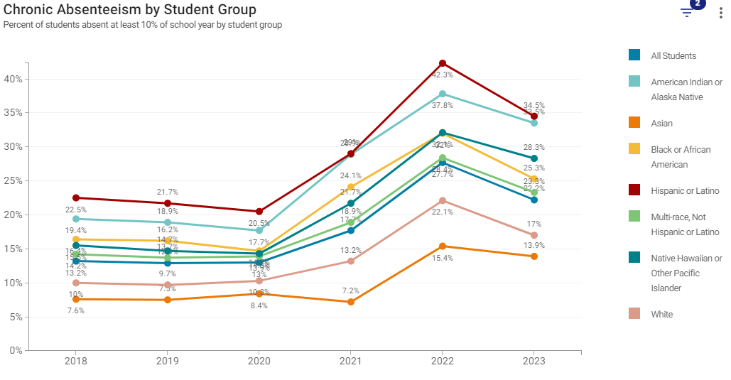
Massachusetts Trends by Race/Ethnicity
Additional Insights
2 out of 5 Hispanic high school students miss 10% of school or more
More MA districts impacted:
March 2024: 338 districts and 1486 schools (10%+)
2018-19: 198 districts and 913 schools (10%+)
Chronic absenteeism varies by race/ethnicity
Percent absent at least 10% of school year
From MA Department of Education August 2024 presentation
Notes:
https://www.edweek.org/leadership/teachers-view-chronically-absent-students-less-favorably/2024/06

Slide 15
Health-Related Barriers to Learning
APA Children’s mental health is in crisis 2022 Trends Report
AAPD The State of Little Teeth Second Edition
CDC Data and Statistics on Children’s Mental Health
CDC About Teen Pregnancy
KFF The Landscape of School-Based Mental Health Services
Notes:
This slide shows the more common health-related barriers to learning. This includes common illnesses and injuries, asthma, behavioral health issues, obesity, teen pregnancy, vision problems, and tooth pain.
Nearly 1 in 5 children experiences a behavioral health problem during their school years. Roughly 80 percent of those children, due to both stigma and barriers around access, don’t receive the necessary treatment. Students with behavioral health issues also miss over twice as many school days as those without behavioral issues. If school is perceived as emotionally or physically unsafe, students often choose to avoid school all together. Bullying is a prime example.
Additionally, teen pregnancy is a leading cause of school dropout for adolescent females. Pregnant teens are more likely to rely on public assistance, more likely to be poor as adults, and more likely to have children who have poorer educational, behavioral, and health outcomes.
Another common reason students miss school is due to dental caries, which are the most common chronic disease of childhood. Two million days of school are missed annually due to dental health related problems. Children with poor oral health are nearly 3 times more likely to miss school.
Lastly, COVID, RSV, flu, and high levels of anxiety are also contributing to absenteeism among all students, but especially young learners.
Each of these health problems can influence student motivation and ability to learn and can adversely affect academic achievement, school connectedness, and attendance.

Slide 16
The Link Between Chronic Absence and Health
Chronic absence is a warning sign that a health-related condition or a social determinant of health may need to be addressed.
Children with acute and chronic health conditions are more likely to be absent from school.
Students who are chronically absent from school are more likely to display behavior and discipline problems and engage in unhealthy activities.
Chronic absence is an early warning sign that students are off track for reading by the end of third grade, completing middle school, and graduating from high school.
Addressing the Health-Related Causes of Chronic Absenteeism: A Toolkit for Action
Vital Signs for Pediatric Health: Chronic Absenteeism
Associations of health risk behaviors with school absenteeism.
Chronic Absenteeism Among Kindergarten Students
The Importance of Being in School: A Report on Absenteeism in the Nation’s Public Schools
Present, Engaged, and Accounted For: The Critical Importance of Addressing Chronic Absence in the Early Grades
Preschool Attendance in Chicago Public Schools: Relationships with Learning Outcomes and Reasons for Absences
Chronic Absenteeism in Utah Public Schools
Notes:
Paying attention to chronic absenteeism is important because research shows a strong connection between chronic absence and health.

Slide 17
From : Heidi Schumacher, MD FAAP
Assistant Professor of Pediatrics, Univ of Vermont Larner College of Medicine
Burlington, VT at AAP NCE Council Showcase 2023
Notes:
Chronic absenteeism is found among students of every race and ethnicity but disproportionately affects specific student populations. Recent national data has shown that American Indian students were 81% more likely to be chronically absent than their White peers, Pacific Islander students 50% more likely, and Black students 44% more likely (Attendance Works and Everyone Graduates Center, 2021). Racial and ethnic disparities vary by state, however, with some states showing White students more likely to be chronically absent compared to Black students (Chang et al., 2018). Emerging state-level data suggest that the COVID-19 pandemic has exacerbated disparities in chronic absenteeism. In Connecticut, for example, a preliminary analysis showed that chronic absenteeism more than doubled among English language learners and increased 75% among students eligible for free and reduced-price meals in the 2020–2021 school year compared to the prior year (Chang et al., 2021).
Before the pandemic, chronic absenteeism was three to four times higher among low-income students, who may most benefit from being in school (Balfanz and Byrnes, 2012; Chang and Romero, 2008). National data suggest a correlation between school poverty levels and chronic absenteeism, with poverty being a stronger determining factor than location. The literature shows that high rates of chronic absenteeism among those living in poverty are likely due to an array of parental and family risks, including single-parent households, low parental education, family unemployment, food insecurity, poor family health, and having multiple siblings (Chang and Romero, 2008). However, there is variability in chronic absenteeism rates among low-income communities, suggesting that there may be child and family factors operating alongside issues related to schools or communities that may serve as either risk or protective factors.
Students who are at risk for lower educational attainment (e.g., those in special education, alternative, and vocational programs) are more likely to be chronically absent. In 2017–2018, students receiving services under the Individuals with Disabilities Education Act had a chronic absence rate of 23.4%, 46% higher than students overall (Attendance Works and Everyone Graduates Center, 2021). Improving

Slide 18
Chronic absenteeism as a vital sign
Absenteeism:
A vital sign for both individual youth and the health of the educational system?
https://nam.edu/wp-content/uploads/2023/06/Pediatric-Vital-Signs-Series-17.png

Slide 19
Poll
Notes:
Mona question:Poll Question 1: Chronic abseentism rates are highest in children PreK/K and high school than elementary.

Slide 20
Reducing Chronic Absence Requires Addressing Underlying Causes of Absenteeism Including Health Challenges and Social Determinants of Health
Barriers
Aversion
Disengagements
Misconceptions
Chronic and acute illness
Family responsibilities or home situation
Trauma
Poor transportation
Housing and food insecurity
Inequitable access to needed services (including health)
System involvement
Lack of predictable schedules for learning
Lack of access to technology
Community violence
Struggling academically and/or behaviorally
Unwelcoming school climate
Social and peer challenges
Anxiety
Biased disciplinary and suspension practices
Undiagnosed disability and/or lack of disability accommodations
Caregivers had negative educational experiences
Lack of challenging, culturally responsive instruction
Bored
No meaningful relationships to adults in the school (especially given staff shortages)
Lack of enrichment opportunities
Lack of academic and behavioral support
Failure to earn credits
Need to work conflicts with being in high school
Absences are only a problem if they are unexcused
Missing 2 days per month doesn’t affect learning
Lose track and underestimate TOTAL absences
Assume students must stay home for any symptom of illness
Attendance only matters in the older grades
Suspensions don’t count as absence
Portraits of Change: Aligning School and Community Resources to Reduce Chronic Absence
Addressing the Health-Related Causes of Chronic Absenteeism: A Toolkit for Action
Notes:
Thank you, Dr. Roberts. I think we all have a better grasp of the definitions,scope and impact of the problem of chronic absenteeism, which isn’t really a new problem but it has most definitely grown in all dimensions in the past 4 years.
So let’s talk about how we physicians, nurses, and other clinical teams can be strong partners in reducing the burden of absenteeism for families in our care and throughout our communities. Let’s keep in mind that we are not talking about eliciting new conditions or complaints. Instead, we may actually be able to find more efficient and effective ways to discover and address issues that already concerning to us and our patients.
What are the barriers, the cognitive or emotional aversions to attending school, the factors that disengage families and students from school and the perceptions that may lead to less acceptance of back to school messaging and which ones are we as health professionals most able to identify and impact? This list is far from inclusive but we can see that the list in the first column include both acute and chronic illness, disparities in access to health services, buit also other social drivers that many of you are already addressing. I’ve highlighted in red the obvious points of intervention in the columns like anxiety and undiagnosed disability. But in our discussions with families we may also gain valuable information such as social and peer challenges like bullying, academic struggles that may point to learning disorders or ADHD, or trauma.
Overall, please know that using a trauma-informed lens on the experiences of preschool to school age children and their family is the first step in using relational care to improve the school experience and to reduce absenteeism.
In order to reduce chronic absenteeism, we must address the underlying causes of absenteeism.
Solutions require understanding why students miss school.
Typically, these reasons are divided into four big buckets – Barriers, Aversion, Disengagement, and Misconceptions.
As you can see many of the reasons are related to health challenges and social determinants of health.
Understanding which factors are causing absences helps you respond to individual students and recognize when a broader programmatic or policy solution is needed if many students are affected.

Slide 21
Improving Attendance Requires A Multi-tiered System of Support
Tier 3
Intensive Intervention
Students Missing 20% or More
Tier 3
Intensive Intervention
Students Missing 10% - 19%
Tier 2
Early Intervention
All Students and Families
Tier 1
Universal Prevention
Foundational Supports
Which Promote Positive Conditions for Learning
All Students and Families
Attendance Playbook: Smart Solutions for Reducing Student Absenteeism Post-Pandemic
Chronic Absence 3 Tiers of Intervention
Notes:
Any of us who have interacted with systems like public health and education have seen this multi-tiered model of intervention. I don’t want to linger too long on this one model but did want to point out that your local school districts will undoubtedly be structuring their approach to supporting students with this pyramid. Both the foundation of the pyramid and tier one are focused on providing positive conditions for learning and engaging for all students and families. We want the school to be a place of comfort, safety and growth that ensures that all students are motivated just to show up every day. That investment in prevention and identification allows for the Tier 2 of early intervention
Tier 2 identifies students who are missing 10-19% of school days and provides early supports for these students.. Lastly, tier 3 offers intensive interventions for students who have already been identified as missing 20% of school days and who are facing the greatest challenges to getting to school.
You may even hear of these tiers as you speak with teachers, school nurses about a specific student or with admniistrators as you attempt to make positive change on the system level.

Slide 22
Evidence-Based Health Interventions Across Multiple Tiers That Improve School Attendance
School Policies
Improving school climate and student connectedness can lead to improved attendance and a decrease in risky behaviors.
A Whole School, Whole Community, Whole Child approach can help promote student health and improve academic performance.
Infection Prevention and Screenings
Support hygiene practices, school-based vaccination programs, and more.
Implement screenings for vision, dental, behavioral health, chronic health issues, food/housing insecurity, etc.
School Nurses
Have one full time nurse in every school! 95% of students who see a school nurse are able to return to class.
School-Based Health Centers
There is a 25% decrease in tardiness and 50% decrease in absenteeism for HS students who received school-based mental health services.
Mental Health Services
A trauma informed approach in schools can help decrease suspensions and improve attendance and school performance.
Notes:
Please know that both the Department of elementary and secondary education and every local school is working hard to identifies the system changes that help all students and more fine tuned changes to help the students most in need. TheWhole School, Whole Community, Whole Child approach is taken by schools and school health departments to promote student health and improve academic performance. Where can we lend a hand? I will address specific steps in a moment but remember that you have expertise in infection prevention and screenings, can communicate your observations and offer an ear to the professional observations of both school nurses and school based health centers. If you don’t know much about school nurses or school based health centers, remember that .
studies show that 95% of students who see a school nurse are able to go back to class. Without a school nurse that number drops to 83%. Additionally,
School-based health centers provide comprehensive health services to students who may not be able to receive them otherwise and have also been proven to keep kids in school, with a 50% decrease in absenteeism for high school students who received school-based mental health services.

Slide 23
What can I do as a primary care pediatrician, family physician, or nurse practitioner?
Youth and Family
Practice Level
Community Level
System/State Level
Notes:
So let’s start in your exam room and identify specific changes or supports you can offer directly to youth and their families, how you can set up your practice to support return to school, and how you can be a resource on the community level and partner with other child health and education professionals to improve the situation on the community and the system level.

Slide 24
Raise Office Staff and Parent Awareness
Staff Awareness (“excuse notes”)
Family Awareness
Start in PreK and K
Tie topics like sleep, hygiene, and symptoms to school attendance.
Notes:
Let’s just start with awareness. When you ask children what their school experience is, starting in early childhood education, you can have a strong impact on how families see the schools role in their children’s lives. I love that the smallest verbal child will always say they go to school, even when they are two years old and in childcare. Let’s take that and run with it. “You go to school? That is amazing. Did you know that going to school every day makes you learn more and be healthier?” Explain to parents that a positive attitude about attending school every day in preschool has been shown to improve THIRD and FOURTH grade reading scores so “keep up the good work”. When we are talking about nutrition and sleep, tie it back to school and show that you care about a child’s success in school and have a stake in helping them enjoy school every day. Be the physician or nurse practitioner who cares about school every time you see a child. It’s contagious.
So it is contagius to families. You know who else can catch the bug of “back to school”? Your support professionals. Front desk and call center staff, medical assistants, and nurses can all have “scripts” that double down on getting children back to school after morning physicals, back to school quickly after a fever subsides, and staying in school before and after school holidays.
But if there is ONE action that is going to give you the most bang for your buck, here it is: ASK THE QUESTION: HOW many days of school did you miss in the past month? You can switch it up in September to say “last year” or adjust it in other ways. But any of us who do this regularly find out that children who socred perfectly on the Astama control test are missing school due to asthma, menstrual pain is keeping other children home, and headaches or anxiety all of a sudden come up. This is what I call the Million dollar question because it answers most of the other questions I would normally ask in the visit. I ask it in well visits and often in sick visits. Try it.

Slide 25
Strong School Attendance Starts Young
Chronic Absenteeism Starts Early
Lay the Right Foundations from the Beginning:
Healthy Habits
Notes:
You don’t NEED to change your focus in a visit. You regularly lay the foundations to good health with hygiene, physical activity, nutrition and sleep. Now just connect the dots for families and remind them that we are all motivated to tackle the sleep problems because we know how hard poor sleep makes the parents morning school routines. And if we can start talking about healthy habits and not missing school needlessly at age 4, we are already giving a child a leg up on school attendance success.

Slide 26
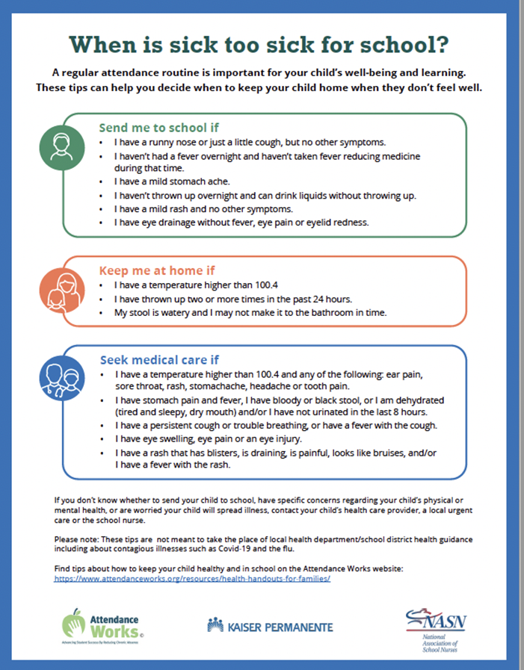
Make the Case for Daily Attendance to Families
Attendance Is How Kids Learn
Call Our Office so We Can Support You
https://www.attendanceworks.org/resources/handouts-for-families-2/
Notes:
Now, I don’t know about you, but I heard a lot of confusion about going back into the childcare, preschool and school classroom during the different phases of the COVID pandemic. Especially when schools had their own staffing challenges, they really didn’t want a child with a bad cough, pinkeye,or rash back in the classroom. Parents are still confused and sometimes honestly I am too. We can share some really helpful tools from Attendance Works with all parents to guide them when they are facing a sick child at 6:30 before the bus is about to come.

Slide 27
Give Parents Tools and Skills
Handouts from Attendance Works and AAP
Waiting Room Video at https://www.attendanceworks.org/resources/videos/bringing-attendance-home-video/
Notes:
I want to show you a few great parent-facing handouts from Attendance Works that will be available with links in this slide deck. Also check out their waiting room video all about attendance and why going to school is the best decision a parent can make for their child.

Slide 28
Raise Awareness and Prevent Illness during Well Child Visits,
Urgent Visits, and with Chronic Condition Management
https://www.attendanceworks.org/resources/health-handouts-for-families/
Notes:
Nutrition/sleep/Exercise, Hygiene, Safety, Wellness and Engagement are topics that pediatricians are already talking about but we can tie all of these important topics to “keeping kids in school”

Slide 29
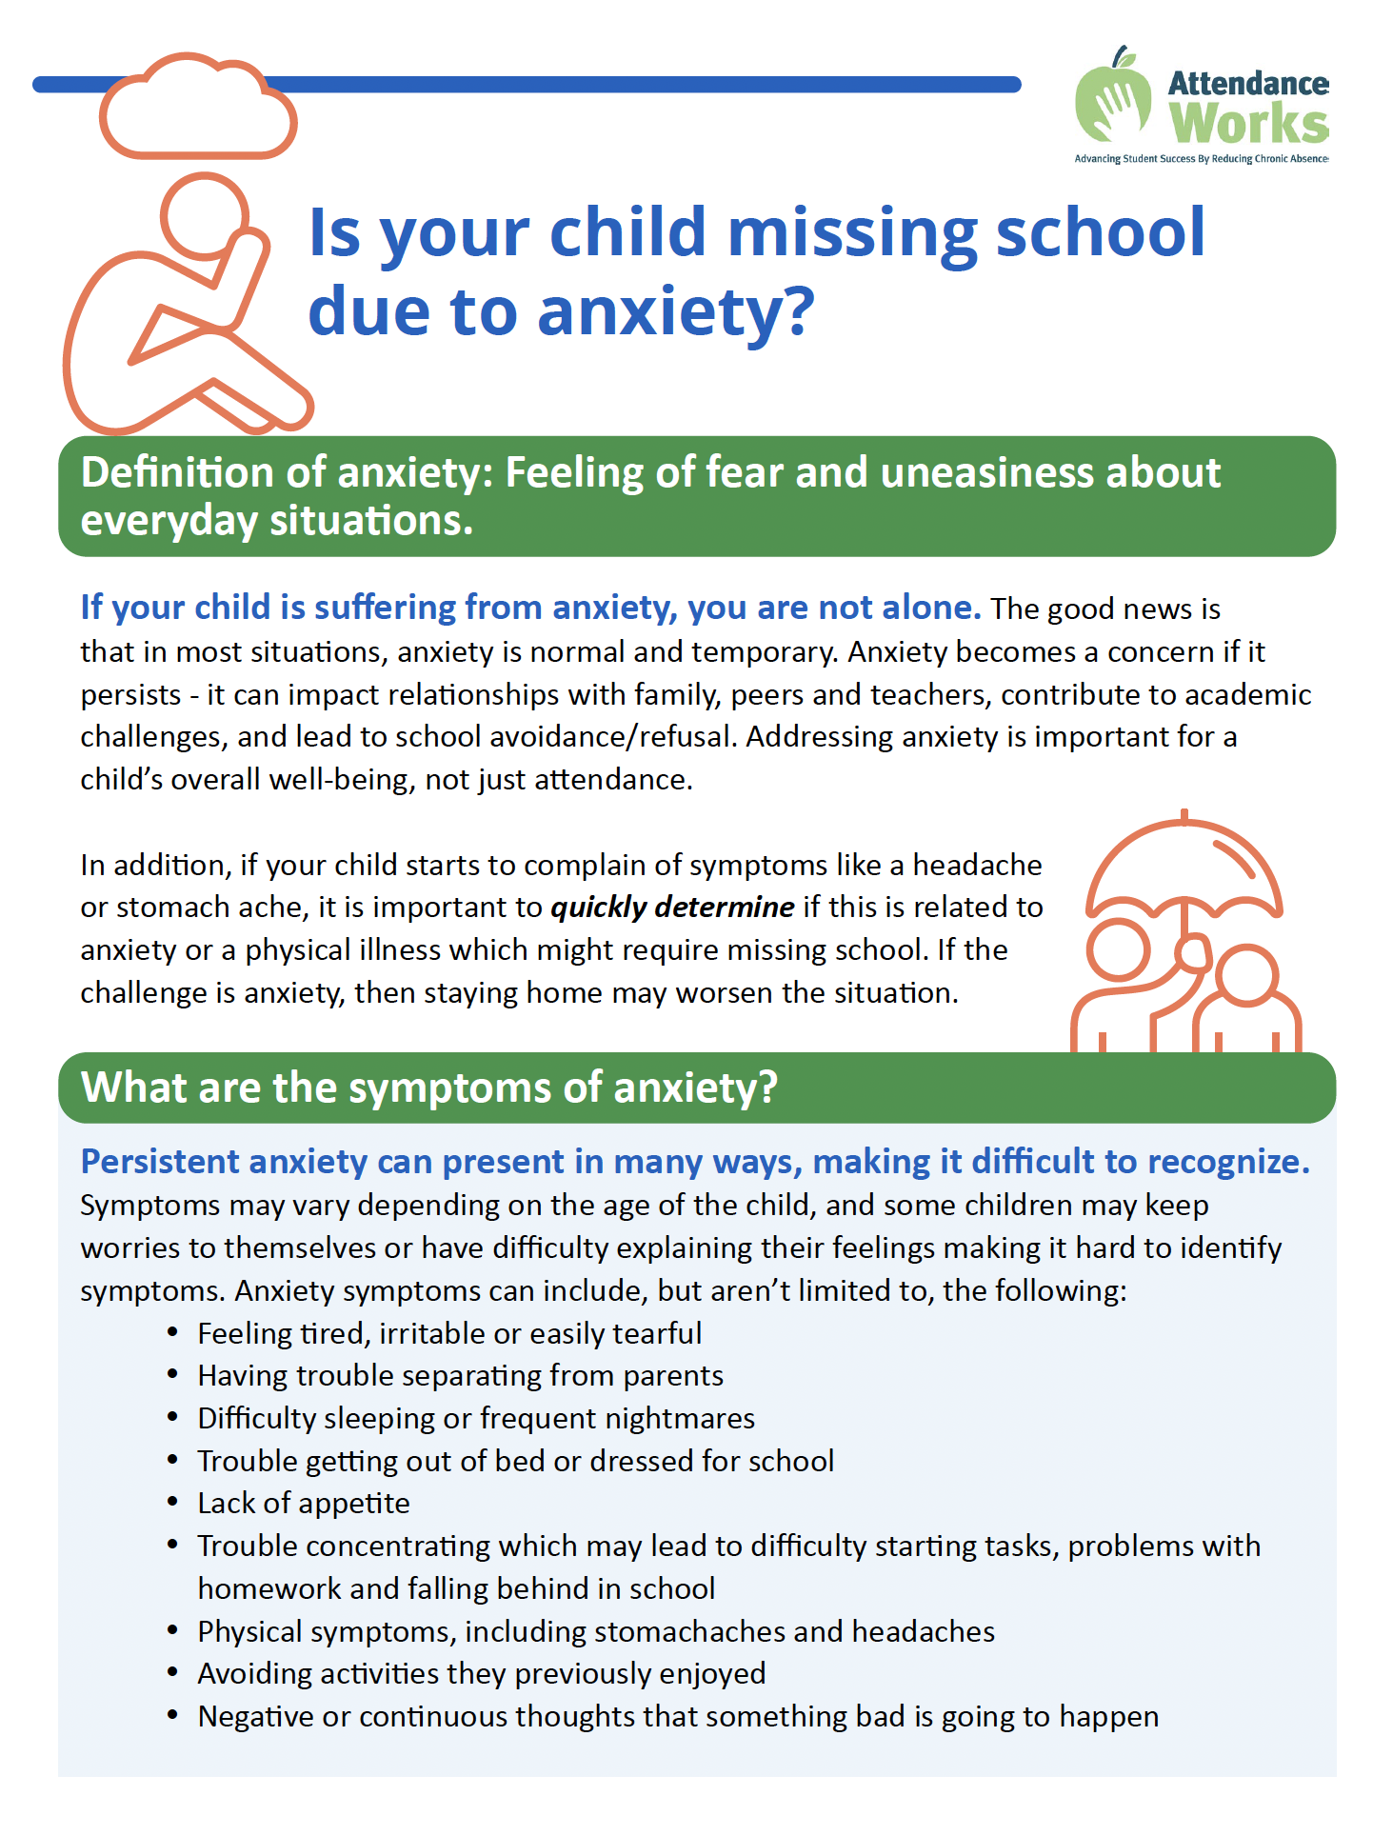
Parent Handout on Anxiety
This handout provides answers to key questions:
What are the symptoms?
When does anxiety become a problem?
What can families do to support their child?
How can schools and health providers help?
Where can I find additional information?
https://www.attendanceworks.org/take-action/community-and-agency-partners/health-care-providers/
Notes:
Let’s really pay attention to the links between social and emotional health and school attendance. Anxiety is a frequent culprit in school absenteeism. I don’t know about you, but I loved school but after I had been out for a few days of illness, I would get butterflies in my stomach the night before I went back. We have worry, we have worry’s big sister anxiety, and both of these can be big issues for parents to face alone. But we can ask some key questions and make ourselves important team members.
There was a significant POST COVID increase in behavioral health issues, and especially anxiety. That makes sense. Being out of school for weeks and months, or even over a year is bound to make the whole family anxious.
So that parents would know what to do if their child is dealing with anxiety issues, Attendance created a resource that that provides an overview of anxiety.
It outlines the definition of anxiety, typical symptoms, things that families can do and the importance of taking advantage of school resources and connecting with a health care provider if things don’t improve.
Asking about missed days of school really can help us uncover hidden anxiety.

Slide 30
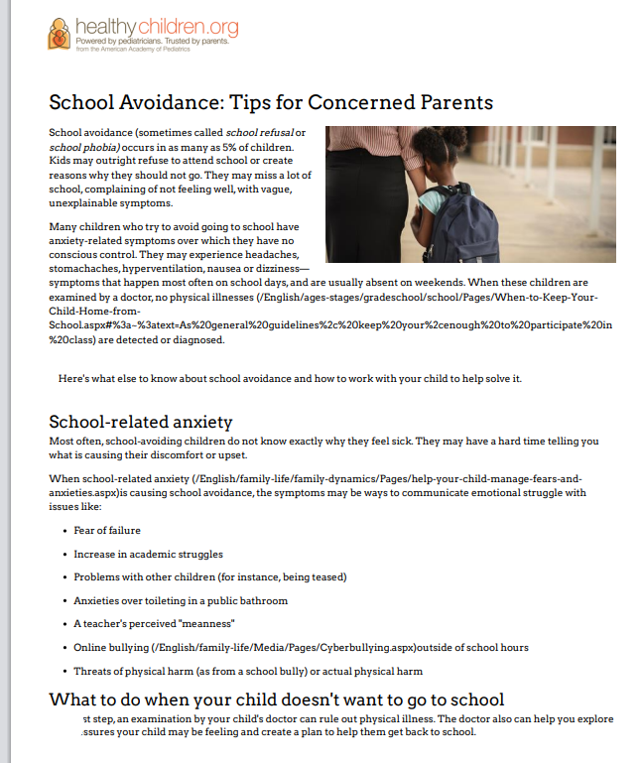
The Challenge of School Avoidance
https://shorturl.at/JN4x7
Notes:
And the cousin of anxiety? School avoidance. Now, not all children who aren’t in brick and mortar school are avoidant. There are successful homeschooling students at every level. My son, who was homeschooled at different times in his K-12 years graduated college and grad school and his college valedictorian was a homeschooler. But lets not mistake a positive choice to provide meaningful home education with a reactive response to a school avoidant child or teen.
Mostly be open and curious and show parents that we can be valuable team members to support school avoidance. It is one of the toughest challenges a parent will face.

Slide 31
Explain to Parents Why Attendance Matters in PreK through First Grade
Across the nation, one in four kindergartners are chronically absent.
17% of children with chronic absenteeism in kindergarten AND first grade were reading at grade level in third grade.
Notes:
Again, parents are starting to hear about absenteeism from the schools but we have the benefit of really long term relationships with families. Make sure you know the facts about missing school and learning to read on time. Because attending school is the way most children learn best and missing school means trying to catch up on your own.

Slide 32
Champion Strong Attendance and Health in Early Childhood Education
Work with your local Head Start and other early education partners even if they don’t have an official school nurse
Build awareness that your office is on the “back to school” team
Advocate for bidirectional communication. Reach out to the programs with questions about “return to school” protocols.
Offer education or handouts on safe return to school for infectious diseases.
Be a resource for school nurse or teacher health questions.
Notes:
On the Community level, we and our practices can make sure our local head starts and early education sites feel comfortable reaching out to us with questions or concerns.
If everyone in the community knows that your office is part of the “back to school” team, the family receives support at all levels.
If you have questions about a school’s back to school policy for a sick child, pick up the phone. Make sure there is a designated person or more than one person in your office that early childhood programs can call to communicate too.
The AAP has some return to school handouts for infections in childcare. If there are questions, send one along.

Slide 33
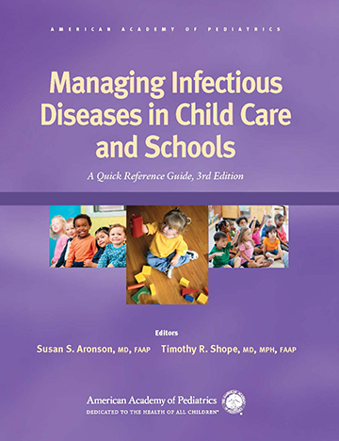
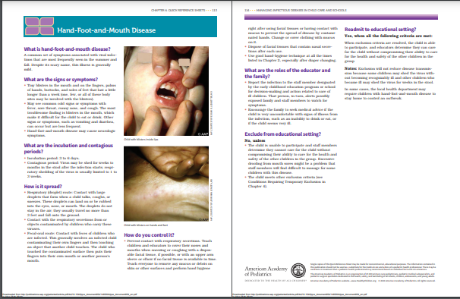
Pediatricians can treat students AND educate our partners in education

Slide 34
Build Partnerships with Schools and School Nurses
Partner with school nurses on “get back to school” messages
Educate yourself and school staff on and protocols (fever, emesis, pink eye).
Utilize school health to administer acute and chronic medications.
Respect FERPA and HIPAA while communicating with school health.
Create workflows to keep school medication orders, school refills, and action plans updated.
Offer help with IHPs & IEPs.
Notes:
Have a team meeting once or twice a year to educate your whole team about school health and back to school protocols. Maybe even invte a school nurse to zoom into your meeting and forge stronger relationships.
Create workflows to make sure children with school medications get their prescription refills, asthma or allergy action plans. and school med orders at their annual preventive visits or by the first day of school. School health medications can be a lifesaver for families who are rushing children out the door every morning.
Communication is really the key. Make it easy to communicate with school staff by having a release on the chart to give them information and hear what is going on with your patients. If you need help with understanding how HIPAA and FERPA apply to bidirectional communication, reach out and we will give you a hand.
Finally, remember that kids with IEPs and IHPs have chronic conditions so offer to help families get the right assessments and right plans to keep their child comfortable and safe going to school and to give the parents confidence the child will remain healthy in school. Many parents don’t have that trust so they keep their child out of school more often.

Slide 35
Understand What Absenteeism Looks Like in Your Community
https://profiles.doe.mass.edu/statereport/attendance.aspx
Notes:
We can look at what’s going on in our surrounding communities by accessing the attendance dashboard from the state. Massachusetts has been going in the right direction statewide and a few schools stand out but maybe its time to see what is going on in your backyard and offer help if they are struggling.

Slide 36
What Interventions Make Significant Differences?
School Nurses in the Building
ADVOCACY
95% of students who can see a school nurse get back to class. 83% of students who are in schools without a school nurse return to class on the same day.
Sharon Tennyson, John W. Sipple, Peter Fiduccia, Wendy Brunner, Elisabeth Lembo & Chris Kjolhede (2023) School-based health centers and rural community health, Community Development, 54:4, 549-566, DOI: 10.1080/15575330.2022.2163409
Notes:
We are natural advocates because we get how education and health go hand in hand. Funding issues for school based health centers and a school nurse in every building are perennial local and state issues. If you as a physician show how kids stay in school if they have a school nurse or School based health centers in the building, maybe we would take these valuable services off the budget chopping block.

Slide 37
Improvement? One Step At a Time
School Attendance Is a Necessary Driver of School Success and Health
Chronic Absenteeism is a Health Disparities Multiplier
Notes:
We can have an impact on the individual child and family, with individual schools to bigger communities, to system wide initiatives. We are considered experts in child health so pick one improvement and just do it.

Slide 38
Resources
https://www.attendanceworks.org/
https://nam.edu/vital-signs-for-pediatric-health-chronic-absenteeism/
The Link Between School Attendance and Good Health. AAP Policy Statement 2019.
AAP Council on School Health: School Health Learning Burst Library: https://www.aap.org/en/patient-care/school-health/teams-enhancing-school-health-services/learning-burst-library-school-health/
Notes:
Here are some resources you can use and you will find more on the MCAAP website as well as on Attendance Works and the Council on School health of the AAP.

Slide 39
“Getting Credit”
Complete the evaluation and assessment for CME and MOC 2 credit.
If you are interested in participating in a simple 3-month MOC 4 activity, check that box on your evaluation form or contact Cathleen Haggerty
Notes:
Don’t forget to complete the assessment forMOC 2 credit and I will help you in just a bit. Also, please consider signing up for our simple MOC 4 group. It could literally be a piece of paper and pencil with a tally. Don’t be afraid.

Slide 40
Poll
Notes:
So here is our question to send you off for action. You may also find that the question helps you with your MOC2 assessment.

Slide 41
Please Contact Us With Questions or to Join Our MCAAP Task Force on Chronic Absenteeism
Mona S Doss Roberts, DO, MS
Assistant Professor, Pediatrics, Boston University Chobanian & Avedisian School of Medicine, Ambulatory Care Services
Member of AAP Committee on Practice and Ambulatory Medicine
Mary Beth Miotto, MD, MPH
Immediate Past President, MCAAP
Executive Committee, AAP Council on Quality Improvement & Patient Safety
MAdocforkids@gmail.com
Cathleen Haggerty,
Executive Director, MCAAP: chaggerty@mcaap.org

Slide 42
Acknowledgments
Attendance Works: Hedy Chang, Executive Director
Elliott Attisha, DO, Senior Fellow for Health
Massachusetts Department of Elementary and Secondary Education:
Acting Commissioner Russell D. Johnston
Lisa Harney, Education Specialist
Heidi Schumacher, MD, FAAP, Assistant Professor of Pediatrics,
Univ of Vermont Larner College of Medicine, Burlington, VT
American Academy of Pediatrics Council on School Health:
Carolyn McCarty, Sr Manager, School Health Initiatives
Notes:
Many thanks to our friends at Attendance Works, the Massachusetts Department of Elementary and Secondayr Education, Dr. Heidi Schumacher and the AAP Council on School health.
Now it is time for your questions.

Slide 43
Time for Questions and Observations

