Slide 1

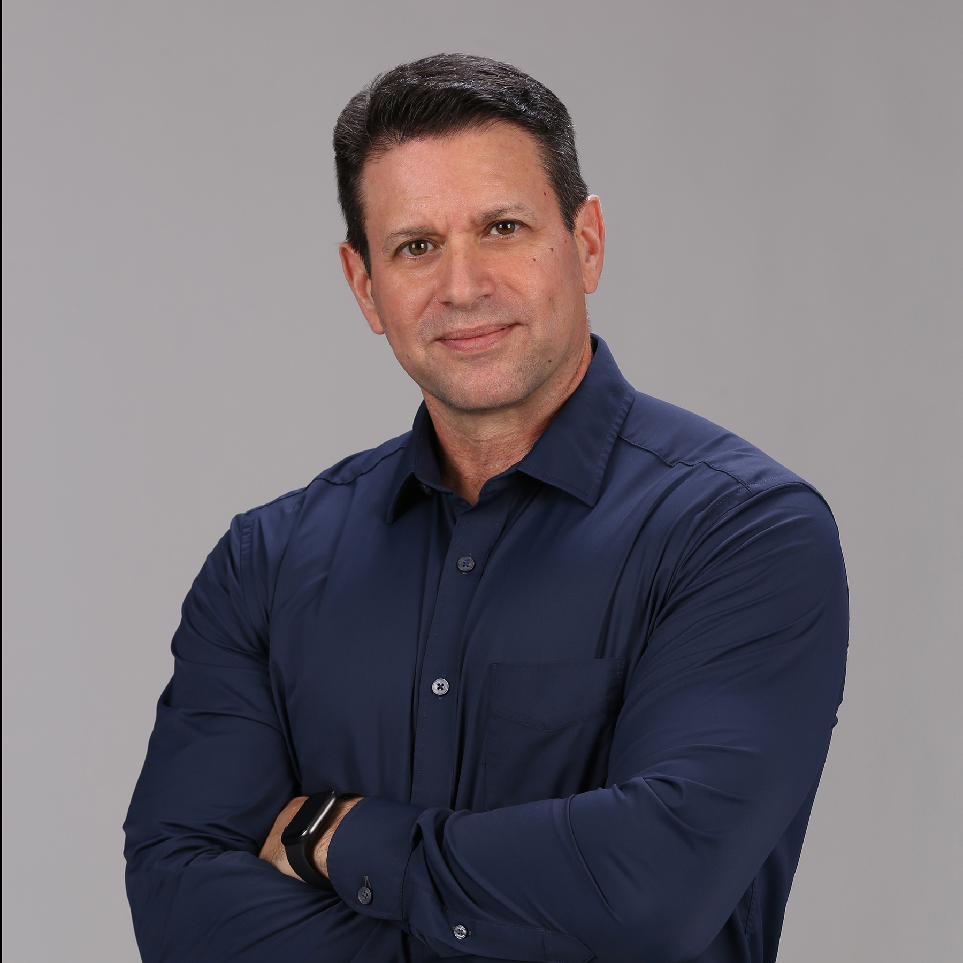
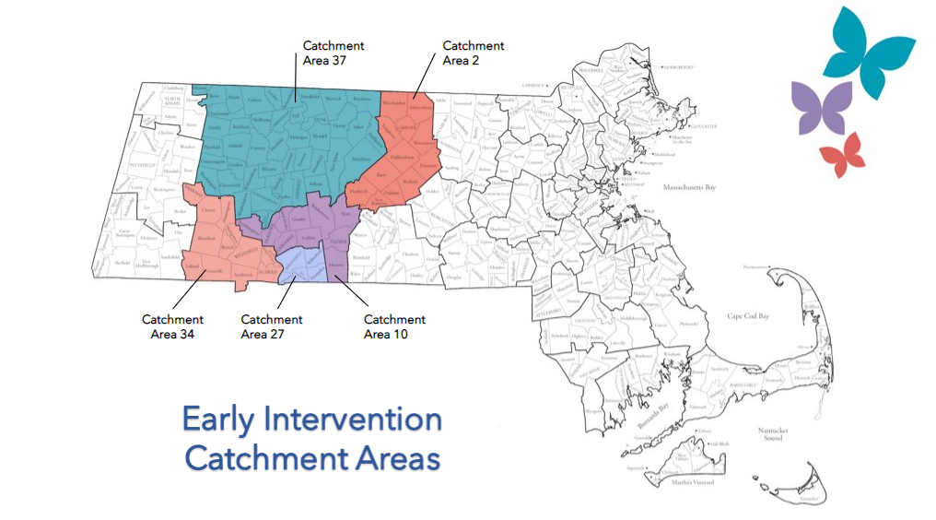

Western Massachusetts: 5 catchment areas
Above age 3 children in Southeast MA
2,000 families; Across 12 states; Ages 1-66
Extensive experience providing EI programs nationwide
Access to language interpretation and translation services
Designated department responds to referral within 24 hours
97% Parent Satisfaction Rating
University Partnerships
Steve Woolf, PhD., BCBA-D
President
Our 6 Treatment Principles
Best Practice
Treatment Plans Informed by the Family
Coordination of Care with All IFSP members
Teaching Essential Skills
Building Rapport and Trust
Focus on Family Participation
DPH EI Philosophy match:
Individualization
DPH EI Philosophy match:
Community
DPH EI Philosophy match:
Team Collaboration
DPH EI Philosophy match:
Life-long Learning
DPH EI Philosophy match:
Respect
DPH EI Philosophy match:
Family Centeredness
Phone: (339) 999-8086 Fax: (844) 364-1273 Email: EarlyIntervention@butterflyeffects.com Website: www.butterflyeffects.com
Notes:
I have extensive EI background. In designing the BE clinical model I wanted to

Slide 2
